Slide 1

RECOMMENDATION SYSTEM TO START A RESTAURANT BUSINESS IN NORTHERN VIRGINIA
IBM Applied Data Science Capstone Project
By: Reeva Bhatkal

Slide 2
Business Problem
Location of a restaurant is one of the most important decisions that will determine whether the restaurant will be a success or a failure.
The objective is to locate and recommend stakeholders, which neighborhood of Northern Virginia will be the best choice to start a restaurant business based on cuisine.
The success criteria of the project will be a good recommendation of neighborhood choice based on lack of such restaurants considering cuisine as a factor in that location and a suitable target audience who has the purchasing power.

Slide 3
Data
Data required:
List of neighborhoods in Virginia
Latitude and longitude coordinates of the neighborhoods
Venue data, particularly data related to restaurants
Source for data:
Web page for neighborhoods (https://data.opendatasoft.com/explore/embed/dataset/geonames-postal-code@public-us/table/?sort=place_name&q=US&refine.admin_name1=Virginia)
Geocoder package for latitude and longitude coordinates
Foursquare API for venue data

Slide 4
Methodology
Web scraping page for neighborhoods list
Get latitude and longitude coordinates using Geocoder
Use Foursquare API to get venue data
Group data by neighborhood and cuisine and taking the mean of the frequency of occurrence of each venue category
Filter venue category by cuisine
Perform clustering on the data by using k-means clustering
Visualize the clusters in a map using Folium

Slide 5
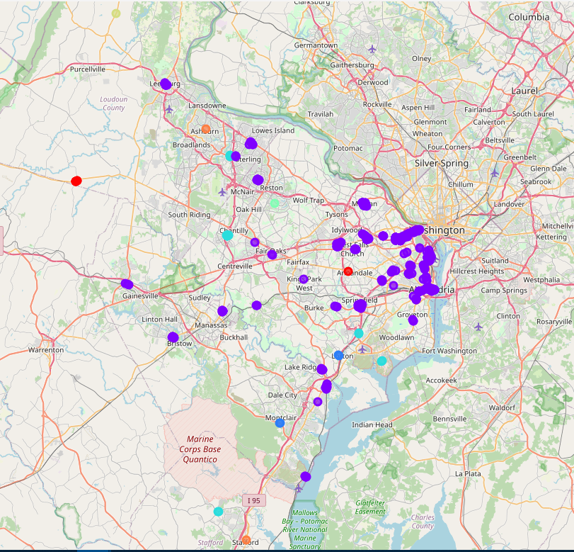
Results
K-Means Clustering
Cluster # | No. of Restaurants
0 | 7
1 | 669
2 | 4
3 | 19
4 | 1
5 | 1
6 | 2

Slide 6
Discussion
Most of the restaurants are concentrated in the northern area of the city.
Highest number in cluster 1 and moderate number in cluster 0 and 3
Cluster 4 and 5 has very low number to no restaurants in the neighborhoods
Oversupply of restaurants mostly happened in the northern regions of the city, with the suburb area still have very few restaurants

Slide 7
Recommendation
Open new restaurants in neighborhoods in cluster 4 and 5 with little to no competition
Can also open in neighborhoods in cluster 0 and 3 with moderate competition if have unique selling propositions to stand out from the competition
Avoid neighborhoods in cluster 1, already high concentration of restaurants and intense competition

Slide 8
Conclusion
Virginia has so many restaurants, yet certain neighborhood or counties do not have a specific cuisine restaurant available.
This analysis is performed on limited data. If good amount of data is available there is scope to produce better results.
In the future, it is a good idea to collect more information about revenue, population, rent payments, crime level, future projects, etc. It will help select a good location inside each county.

Slide 9
Thank You!

